Slide 1
STEP 5 – GATHERING DATA
Round up all those bits and bytes…

Slide 2
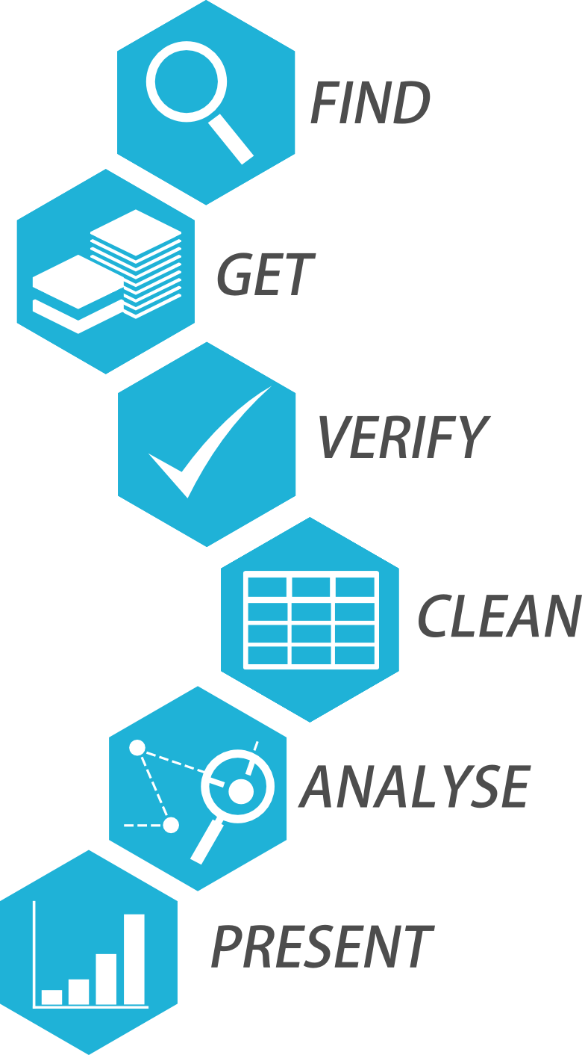
Step 5 Collate All Your Data
Our app is going to contain static and dynamic data
Static data doesn’t change over time and is very often hard-coded into the app
Dynamic data can and will change over time therefore we need a dynamic data source such as an API or database to manage this or maybe even both
At this stage of the project we only need to worry about collating static data as the dynamic data will be handled by our C# application further down the line in the project

Slide 3
Step 5 Collate All Your Data
This is less important for a personal project but can be crucial when working on a commercial project
Best way to do this is to construct a spreadsheet or other tabulated method (such as a table in Word, or records in Access)
For an example of this see my Github

